Slide 1
NORTH SOUTH UNIVERSITY
Lecture 7
PHI 104
Introduction to Ethics

Slide 2
Deontological Ethics

Slide 3
The word deontology derives from the Greek words for duty (deon) and science (or study) of (logos).
In contemporary moral philosophy, deontology is one of those kinds of normative theories regarding which choices are morally required, forbidden, or permitted.
Deontology is against or in opposition to Consequentialism or utilitarianism.

Slide 4
Deontological Theories
In contrast to consequentialist theories, deontological theories judge the morality of choices by criteria different from the states of affairs those choices bring about.

Slide 5
The most familiar forms of deontology holds that some choices cannot be justified by their effects—that no matter how morally good their consequences, some choices are morally forbidden.

Slide 6
For such deontologists, what makes a choice right is its conformity with a moral norm.
Such norms are to be simply obeyed by each moral agent; such norm-keepings are not to be maximized by each agent.

Slide 7
In this sense, for such deontologists, the Right is said to have priority over the Good. If an act is not in accord with the Right, it may not be undertaken, no matter the Good that it might produce (including even a Good consisting of acts in accordance with the Right).

Slide 8
Kantian Ethics

Slide 9
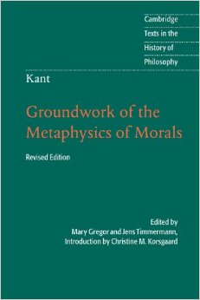
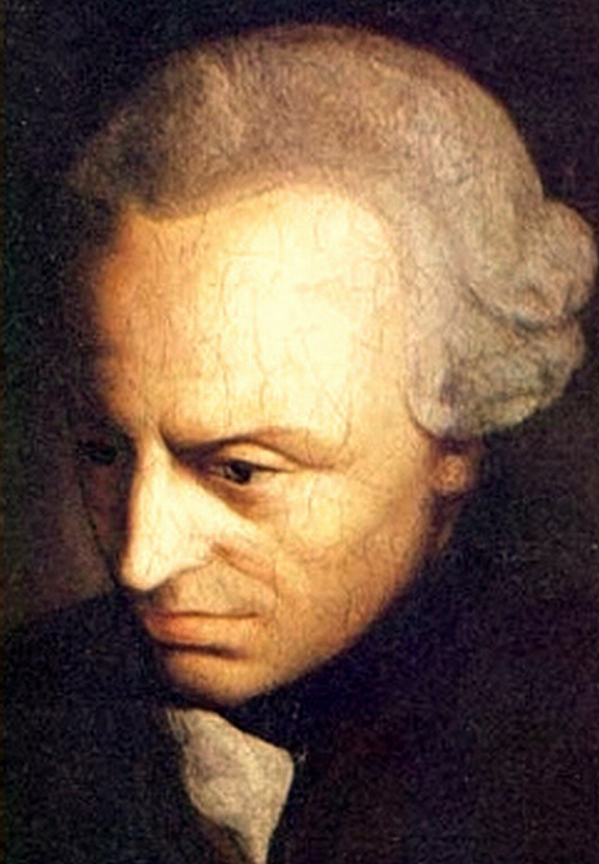
Groundwork of the Metaphysics of Morals

Slide 10
The Supreme Principle of Morality
Its aim is, as Kant himself says, "the search for and establishment of the supreme principle of morality" (AK 4: 392).4 That supreme principle, which Kant calls the categorical imperative, commands simply that our actions should have the form of moral conduct; that is, that they should be derivable from universal principles.

Slide 11
Categorical Imperative
The project of the Groundwork is simply to establish that there is a categorical imperative - that we have moral obligations.

Slide 12
There are moral principles
In other words, Kant is going to start from our ordinary ways of thinking about morality and analyze them to discover the principle behind them.

Slide 13
Good will-unconditional worth
A person who does the right thing for the right reason evinces what Kant calls a good will. A good will is the only thing to which we attribute "unconditional worth.“
The good will is good "through its willing" (AK 4: 394), which means that it is in actions expressive of a good will that we see this special kind of value realized.

Slide 14
Motivation
So what gives a morally good action its special value is the motivation behind it, the principle on the basis of which it is chosen or, in Kantian terms, willed.
Duty is the good will.
We now know what gives actions done from duty their special moral worth. They get their moral worth from the fact that the person who does them acts from respect for law.

Slide 15
Kant’s Moral Law

Slide 16
Moral laws
There are three moral laws or formulas.

Slide 17
First, The Formula of Universal Law
There is, therefore, only a single categorical imperative and it is this:
act only in accordance with that maxim through which you can at the same time will that it become a universal law. (AK 4: 421)

Slide 18
Second, The Formula of Humanity
So act that you use humanity, whether in your own person or in the person of any other, always at the same time as an end, never merely as a means. (AK 4: 429)

Slide 19
Third, The Principle of Kingdom of Ends
the noble ideal of a universal kingdom of ends in themselves (rational beings) to which we can belong as members only when we carefully conduct ourselves in accordance with maxims of freedom as if they were laws of nature.

Slide 20
Limitations
One of the biggest criticisms of Kantian ethics is that it discounts outcome as a valid factor in evaluating the morality of an action. While it is not necessarily wise to rely solely on outcome (as in utilitarianism/consequentialism), it is not a good idea to completely ignore the outcome altogether.

Slide 21
Based on Kant’s formula of humanity, human life is sacred and inviolable, meaning one cannot enslave a few people even if it would enable more people to lead better lives. Killing one person to save the lives of millions is impermissible in Kantian ethics.

Slide 22
Class Work
Ethical Problem Analysis
Is Capital Punishment Morally Justified?
Arguments for Death Penalty
Arguments Against Death Penalty
Religious Views
Your Opinion

Slide 23
Virtue Ethics

Slide 24
Virtue ethics is a broad term for theories that emphasize the role of character and virtue in moral philosophy
rather than either doing one’s duty or acting in order to bring about good consequences.
A virtue ethicist is likely to give you this kind of moral advice: “Act as a virtuous person would act in your situation.”

Slide 25
Virtue ethics is currently one of three major approaches in normative ethics.
It may, initially, be identified as the one that emphasizes the virtues, or moral character, in contrast to the approach which emphasizes duties or rules (deontology) or that which emphasizes the consequences of actions (consequentialism).

Slide 26
Suppose it is obvious that someone in need should be helped.
A utilitarian will point to the fact that the consequences of doing so will maximize well-being,
a deontologist to the fact that, in doing so the agent will be acting in accordance with a moral rule such as “Do unto others as you would be done by” and

Slide 27
a virtue ethicist to the fact that helping the person would be charitable or benevolent.

Slide 28
Most virtue ethics theories take their inspiration from Aristotle who declared that a virtuous person is someone who has ideal character traits. These traits derive from natural internal tendencies, but need to be nurtured; however, once established, they will become stable.

Slide 29
For example, a virtuous person is someone who is kind across many situations over a lifetime because that is her character and not because she wants to maximize utility or gain favors or simply do her duty.

Slide 30
Unlike deontological and consequentialist theories, theories of virtue ethics do not aim primarily to identify universal principles that can be applied in any moral situation.
And virtue ethics theories deal with wider questions—“How should I live?” and “What is the good life?” and “What are proper family and social values?”

Slide 31
Example
A competent adult patient loses a massive amount of blood from a blood vessel bleeding in an acute duodenal ulcer. The best chance of saving his life is an urgent blood transfusion along with operative intervention to arrest the bleeding.

Slide 32
The patient refuses blood but asks for treatment instead with the best available non-blood products, and surgery, accepting the substantial risk that surgery without blood transfusion is much less likely to save his life than surgery with blood transfusion.

Slide 33
The virtue ethicist, after fully exploring the facts and considering the ethical sensitivities, would conclude that a compassionate, trustworthy, and discerning doctor would characteristically respect this patient’s’ wishes in this situation.

Slide 34
Aristotle’s Virtue Ethics

Slide 35
The Nicomachean Ethics
What is the highest good in human life?
What character traits human beings need in order to live life at its best?
In the Nicomachean Ethics, Aristotle answers these question.

Slide 36
He said what we seek is eudaimonia.
Eudaimonia is better expressed as “well-being” or “excellence of performing the proper function”.
The NE has ten chapters or book

Slide 37
NE begins with a discussion of eudaimonia (“happiness,” “flourishing”), and turn to an examination of the nature of aretê (“virtue,” “excellence”) and the character traits that human beings need in order to live life at its best.

Slide 38
In raising this question—what is the good?—Aristotle is not looking for a list of items that are good. He assumes that such a list can be compiled rather easily; most would agree, for example, that it is good to have friends, to experience pleasure, to be healthy, to be honored, and to have such virtues as courage at least to some degree.

Slide 39
The difficult and controversial question arises when we ask whether certain of these goods are more desirable than others.
Aristotle's search for the good is a search for the highest good, and he assumes that the highest good, whatever it turns out to be, has three characteristics:

Slide 40
1. it is desirable for itself,
2. it is not desirable for the sake of some other good, and
3. all other goods are desirable for its sake.

Slide 41
Book 1 Section 7
Definition of Happiness
Since there are evidently more than one end, and we choose some of these (e.g. wealth, flutes, and in general instruments) for the sake of something else, clearly not all ends are final ends; but the chief good is evidently something final. Therefore, if there is only one final end, this will be what we are seeking…

Slide 42
Now such a thing happiness, above all else, is held to be; for this we choose always for self and never for the sake of something else, but honour, pleasure, reason, and every virtue we choose indeed for themselves (for if nothing resulted from them we should still choose each of them), but we choose them also for the sake of happiness, judging that by means of them we shall be happy.

Slide 43
Happiness, then, is something final and self-sufficient, and is the end of action.

Slide 44
if this is the case, and we state the function of man to be a certain kind of life, and this to be an activity or actions of the soul implying a rational principle, and the function of a good man to be the good and noble performance of these…

Slide 45
Any action is well performed when it is performed in accordance with the appropriate excellence: if this is the case, human good turns out to be activity of soul in accordance with virtue, and if there are more than one virtue, in accordance with the best and most complete.

Slide 46
Doctrine of the Mean

Slide 47
Virtue, then, is a state of character concerned with choice, lying in a mean, i.e. the mean relative to us, this being determined by a rational principle, and by that principle by which the man of practical wisdom would determine it.

Slide 48
Now it is a mean between two vices, that which depends on excess and that which depends on defect; and again it is a mean because the vices respectively fall short of or exceed what is right in both passions and actions, while virtue both finds and chooses that which is intermediate. Hence in respect of its substance and the definition which states its essence virtue is a mean, with regard to what is best and right an extreme.

Slide 49
Example
“With regard to feelings of fear and confidence courage is the mean…” (Ibid, p. 40)

Slide 50
Thanks
THANK YOU!!!

